Slide 1

Stability Among Chaos
Bailey Williams

Slide 2
Purpose
Combines Computer Science and Mathematical knowledge to create an exploration and research tool
Uses visualization as a aid to study and organize concepts
Easy to modify depending on the project

Slide 3
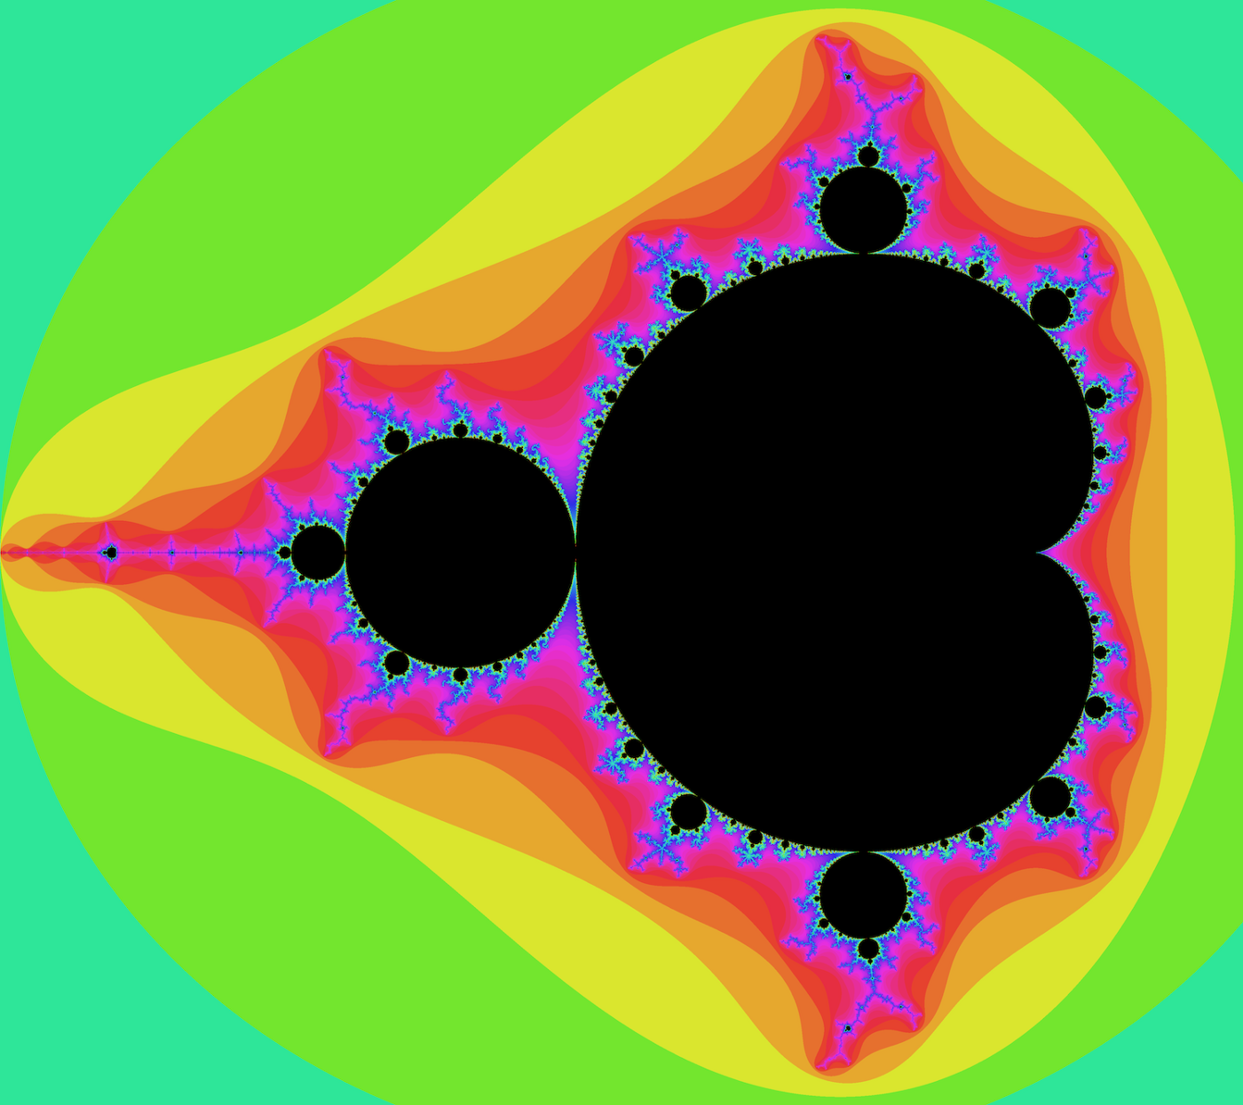
Chaos Theory
The science of predicting the behavior of inherently unpredictable systems.
Orderly effects emerging from chaotic causes.
Examples:
Fractals
Butterfly Effect
Bifurcation

Slide 4
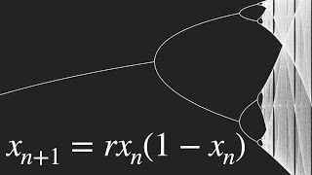
The Bifurcation Equation
$$x_{n+1}=rx_{n}(1-x_{n})$$
$r=$growth rate
$x_{0}=$initial population
$(1-x_{n})=$constraints of the environment

Slide 5
Creating the Bifurcation Diagram
Logistic Equation - Ratio of existing to maximum population
Lyapunov Exponent - Number that measures stability
Bifurcation Diagram - Stable regions within the chaotic region

Slide 6
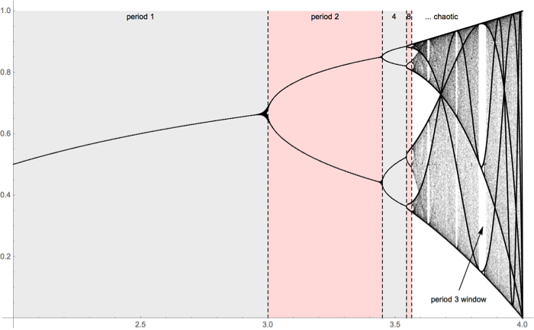
Significance
It is recognizable in everyday patterns.
It helps gain a better understanding of the world and its interactions.
Research of bifurcation has precipitated solutions in many neighboring fields.

Slide 7
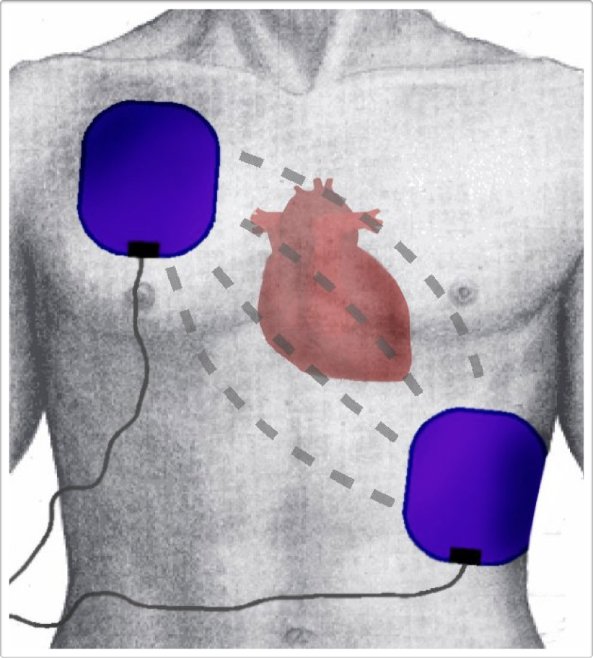



Slide 8
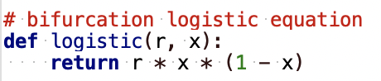
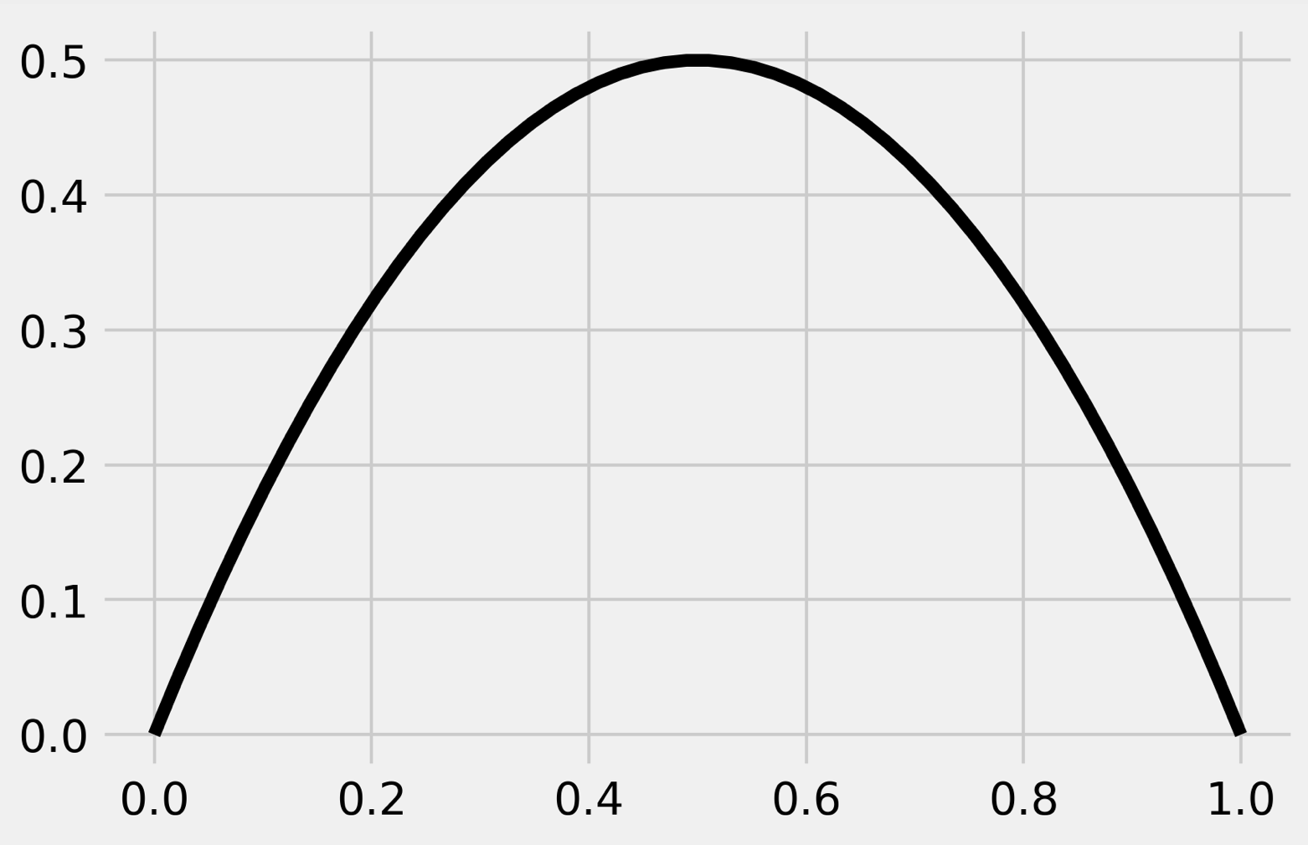
Creating An Exploration Tool
Glade - User interface tool using GTK toolkit
GTK - Features to develop applications (widgets)
Matplotlib - Library which allows the creation of visualizations in Python
Python - Programming language

Slide 9
Sources Cited
12.1. plotting the bifurcation diagram of a chaotic dynamical system. IPython Cookbook, Second Edition. (n.d.). Retrieved April 28, 2022, from https://ipython-books.github.io/121-plotting-the-bifurcation-diagram-of-a-chaotic-dynamical-system/
Visualizations of the connections between chaos theory and fractals through the logistic map. Python Awesome. Retrieved April 28, 2022, from https://pythonawesome.com/visualizations-of-the-connections-between-chaos-theory-and-fractals-through-the-logistic-map/
Bifurcation diagram. (n.d.). Retrieved April 28, 2022, from https://www.vanderbilt.edu/AnS/psychology/cogsci/chaos/workshop/BD.html
Bifurcation diagrams. (n.d.). Retrieved April 28, 2022, from https://www.marksmath.org/classes/Fall2016FractalLAC/demos/BifurcationDiagram/
Jonathan Borwein (Jon) Laureate Professor of Mathematics, & Michael Rose PhD Candidate. (2020, April 15). Explainer: What is chaos theory? The Conversation. Retrieved April 28, 2022, from https://theconversation.com/explainer-what-is-chaos-theory-10620
Sinha, S. (2020, November 19). The bifurcation theory - the logistic curve. Medium. Retrieved April 28, 2022, from https://medium.com/adg-vit/the-bifurcation-theory-the-logistic-curve-ab392e61757d
Sutter, P. (2022, March 18). Chaos theory explained: A deep dive into an unpredictable universe. Space.com. Retrieved April 28, 2022, from https://www.space.com/chaos-theory-explainer-unpredictable-systems.html

